Slide 1

Barrier Reef Orchestra Flow Chart
Home
Welcome to Barrier Reef Orchestra (BRO)
Artists &
Events
List of Events for 2017
Events Featuring an Artist
Artist Profiles
Featured Artist
About Us
North Queensland Ensembles Inc.
Goals of the BRO
History of BRO
BRO Committee
Past Events
Support Us
Registration Form
– Members
– Players
– Benefactor
List of Benefactors
List of Sponsors
Contact Us
Address, Phone & Email Details
Link to Facebook Pages
Send a Message
Acknowledgements

Slide 2

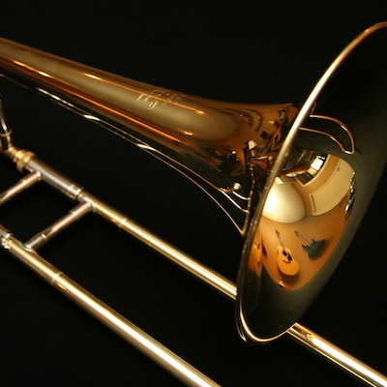
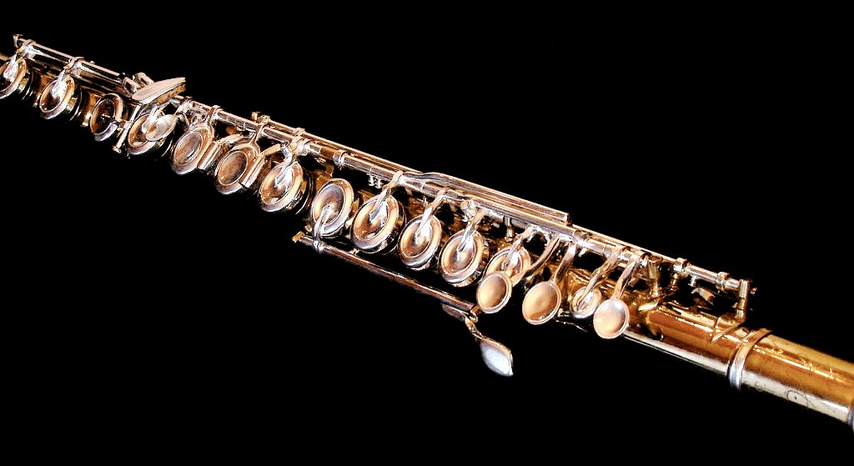
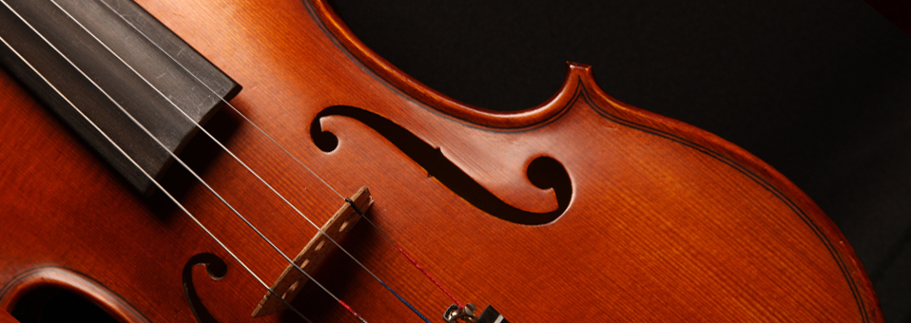




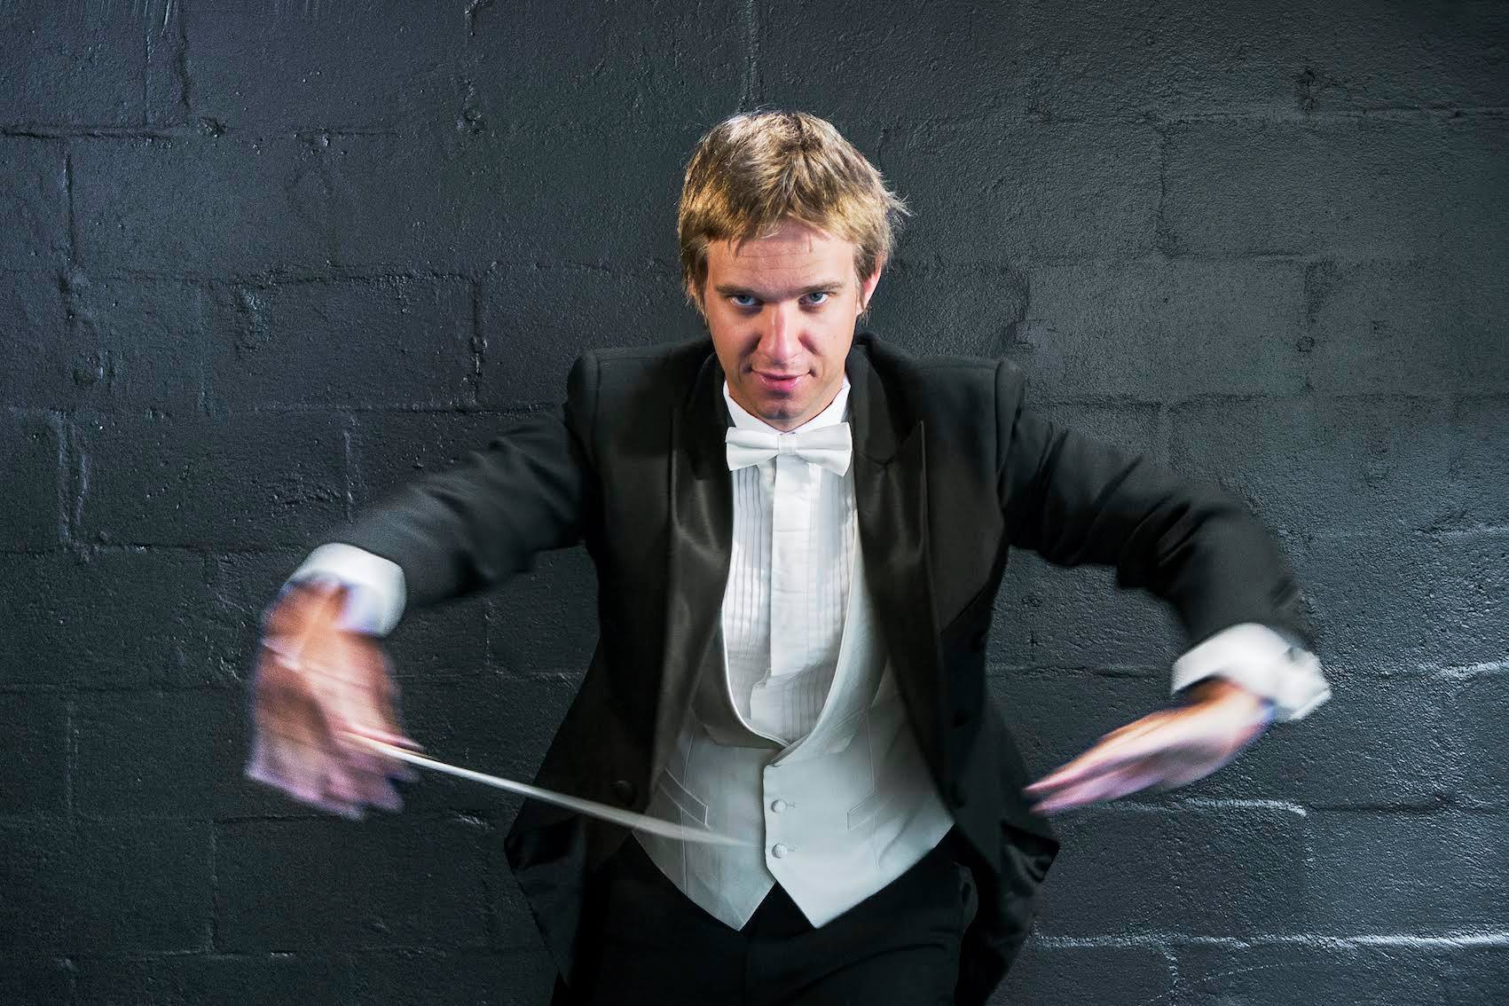

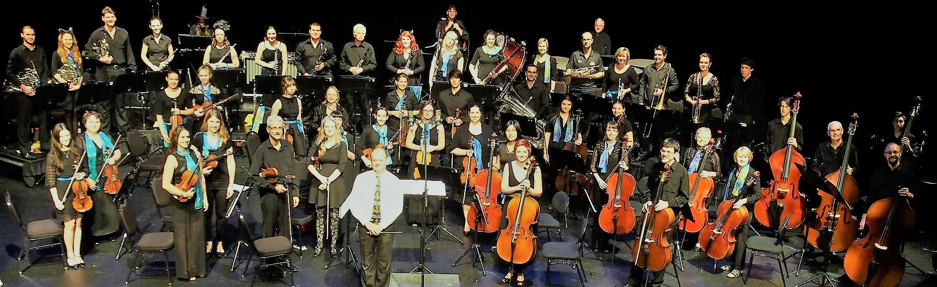






Barrier Reef Orchestra
Search
Home
Artists & Events
About Us
Support Us
Contact Us
Email Us
brotownsville@gmail.com
Barrier Reef Orchestra
Barrier Reef Orchestra
Players
Barrier Reef Orchestra
PO Box 576
Townsville Qld 4810
p: +61 (0) 747 222 789
Home
The Barrier Reef Orchestra is a leading institution of Orchestral Music in North Queensland. It offers opportunities for players of musical instruments to learn and develop skills in an orchestral environment through performing in concerts. The Barrier Reef Orchestra is in its 17th year of performing music. The orchestra is a community organisation consisting of the musicians drawn from Townsville and other locations in North Queensland
Major Sponsor Sponsors Concert Partners

Slide 3
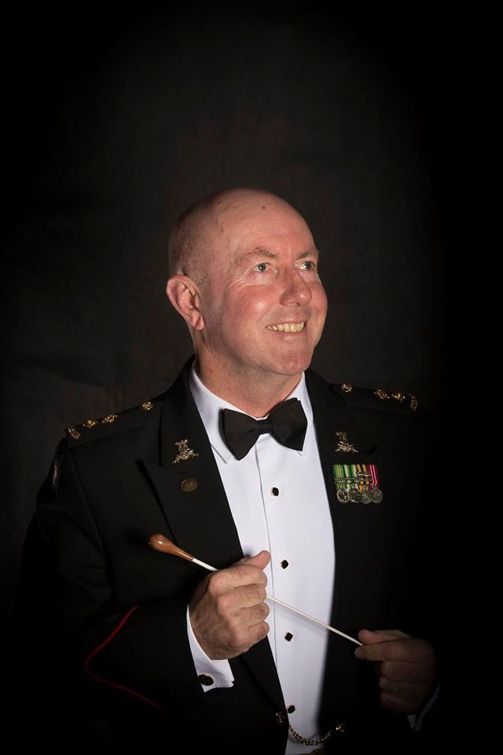
Barrier Reef Orchestra
Search
Home
Artists & Events
About Us
Support Us
Contact Us
Email Us
brotownsville@gmail.com
Barrier Reef Orchestra
Barrier Reef Orchestra
Players
Barrier Reef Orchestra
PO Box 576
Townsville Qld 4810
p: +61 (0) 747 222 789
The Barrier Reef Orchestra is a product of North Queensland Ensembles Inc which is an Incorporated Association registered in the State of Queensland.
In the late nineties, Townsville musicians, arts workers and a group of people who had a love for music realised the potential for developing a community-based Orchestra. As a result, a weekend workshop was arranged in 2000 and musicians were invited to participate the result was the birth of the Barrier Reef Orchestra.
In a typical year the Barrier Reef Orchestra, under the auspices of North Queensland Ensembles Inc, performs three times generally with a guest conductor and occasionally with other performing groups. Smaller ensembles, all utilising players from the Orchestra, regularly give concerts — Orpheus Strings, Pandanus Winds, Kingfisher Trio, Centenary Concert Band and the Barrier Reef Chamber Orchestra.
During the next few years the Orchestra performed with the comedy-duo Scared Weird Little Guys in Score, Townsville City Council’s Last Night of the Proms and A Christmas Carol.
The advancement of the Barrier Reef Orchestra has been profound over the years:
+2006 +2007 +2008 +2009 +2010 +2011 +2012 +2013
+2014 +2015 +2016
Major Sponsor Sponsors Concert Partners

Slide 4
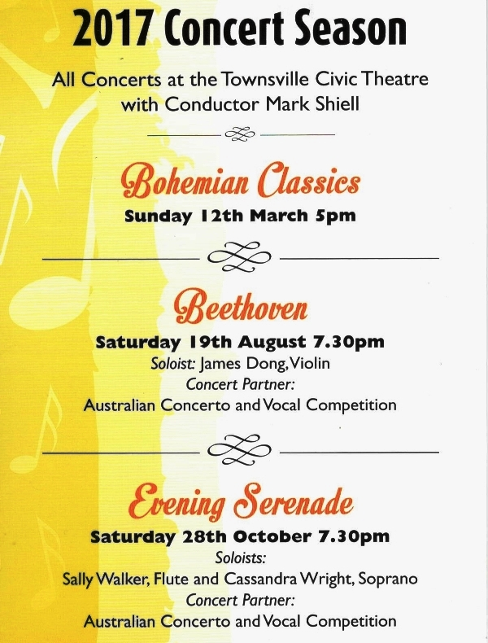
Barrier Reef Orchestra
Search
Home
Artists & Events
About Us
Support Us
Contact Us
Email Us
brotownsville@gmail.com
Barrier Reef Orchestra
Barrier Reef Orchestra
Players
Barrier Reef Orchestra
PO Box 576
Townsville Qld 4810
p: +61 (0) 747 222 789
Our contact details are:
Phone: +61 (0) 747 222 789
Email: brotownsville@gmail.comb
Postal Address: Barrier Reef Orchestra
PO Box 576
Townsville Qld 4810
Major Sponsor Sponsors Concert Partners

